Slide 2
LeNet Trained On:
LeNet was trained on greyscale images and shape of images are 32*32*1.
To recognize digits written in Bank Cheques.
In this architecture, the image shrinks from 32*32*1 to 5*5*16
During that time GPU not available.

Slide 3
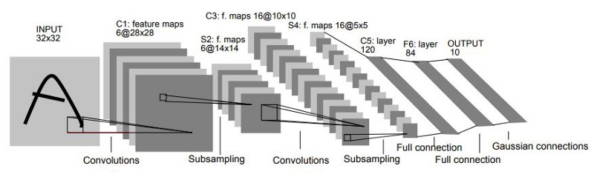

Slide 4
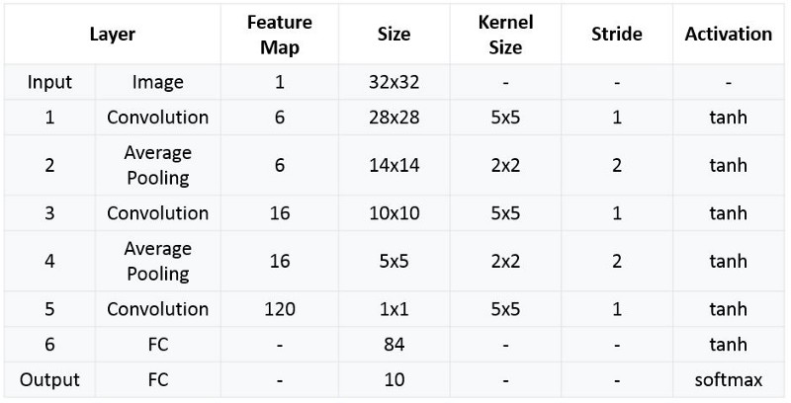

Slide 5
Features of LeNet-5
Every convolutional layer includes three parts: convolution, pooling, and nonlinear activation functions
Using convolution to extract spatial features (Convolution was called receptive fields originally)
Subsampling average pooling layer
tanh activation function
Using MLP as the last classifier
Sparse connection between layers to reduce the complexity of computation

Slide 6
Padding in CNN

Slide 7
Pixels on corner are not cover.
We are missing important information at the edges.

